Slide 1



Kongu Engineering College Department of Computer Application
PLACEMENT MANAGEMENT SYSTEM
GUIDED BY:
Mrs.M.PYINGKODI MCA.,M.phil,PhD
ASSISTANT PROFESSOR
Team Members:
BHAVANA SHREE B S(24MCR011)
ELAMUGIL S(24MCR023)
FATHIM NISHA S(24MCR024)

Slide 2
TABLE OF CONTENTS
ABSTRACT
MODULE DISCRIPTION
PROPOSED SYSTEM
EXISTING SYSTEM
DESIGNING PART
DATAFLOW DIAGRAM(Level 1)
CLASS BASED SYSTEM
PROGRAM IMAGES

Slide 3
ABSTRACT
Web-based application designed to simplify and enhance the campus placement process for students and placement activities.
Centralized platform to organize placement activities, share resources, and foster collaboration among students.
Resource storage and management for placement-related materials such as aptitude questions and interview experiences contributed by students from companies like Wipro, Cognizant, and others.
Repository of knowledge to help students prepare effectively for upcoming placements.
Feedback module for students to share insights and suggestions after attending placement drives.
Categorized database of aptitude questions with solutions, organized by companies, difficulty levels, and topics.
Search and filter functionality for targeted preparation based on specific needs.
Insights into company-specific hiring patterns and expectations.

Slide 4
Student-contributed detailed accounts of placement drives, including interview rounds, technical questions, and HR interactions.
Centralized platform for accessing interview resources, company details, feedback, and placement schedules.
Innovative and practical solution to the challenges of placement management, enhancing the student experience.

Slide 5
MODULE DISCRIPTION
User Registration:
Secure registration for students.
User profiles with personal information and interviews.
Activity Management:
Creation and categorization of activities (e.g., clubs, workshops, seminars).
Detailed descriptions, schedules, and requirements for each activity.
Registration Process:
Simple online registration for students to join activities.
Admin Registration:
Displays link of the events to be happen.
Permits the student to register for the event.

Slide 6
PROPOSED SYSTEM
A centralized platform for managing placement drives.
Student Features:
View available companies.
Register and receive updates on activities.
Admin Features:
View and manage student registrations.
Add or remove questions.
Technologies Used:
Reactjs for a responsive front-end.
MongoDB and Nodejs for real-time data synchronization and seamless back-end management.
Objective: Enhance efficiency, accessibility of Technical and Aptitude questions for students.

Slide 7
EXISTING SYSTEM
Unstructured Resource Management: Placement resources like aptitude questions and interview experiences are scattered, making them difficult to access and manage.
Lack of a Centralized Platform: Students do not have a single platform to access placement-related resources or schedules.
Inefficient Preparation Process: Limited collaboration and sharing of insights among students hinder effective preparation.
No Systematic Feedback Collection: There is no structured way to collect or analyze feedback from students who have participated in placement drives.
No Systematic Feedback Collection: There is no structured way to collect or analyze feedback from students who have participated in placement drives.
Complexity in Managing Placement Activities: The manual and disorganized nature of the process increases the workload for placement coordinators and reduces overall efficiency.

Slide 8
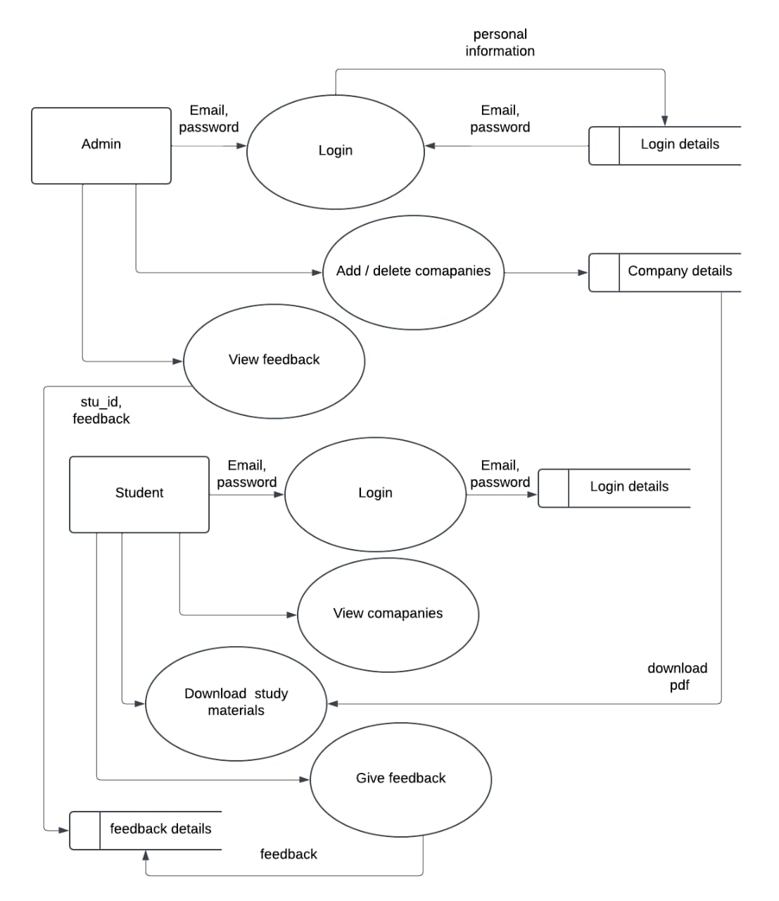
DATA FLOW DIAGRAM LEVEL - 1

Slide 9
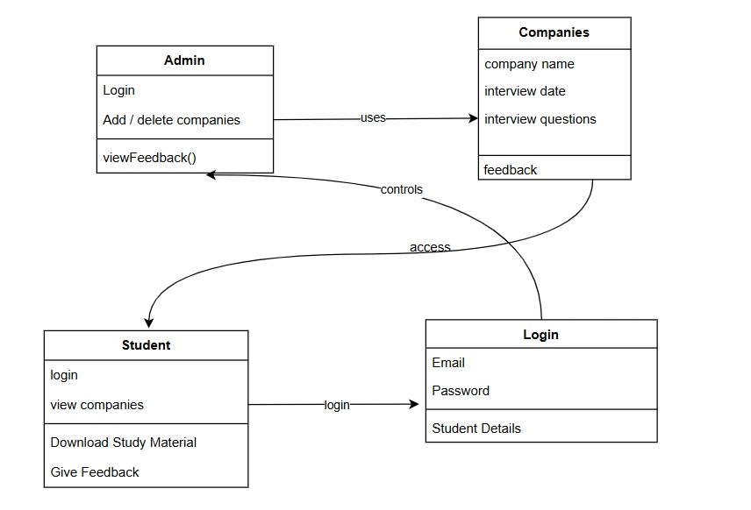
CLASS BASED DIAGRAM

Slide 10
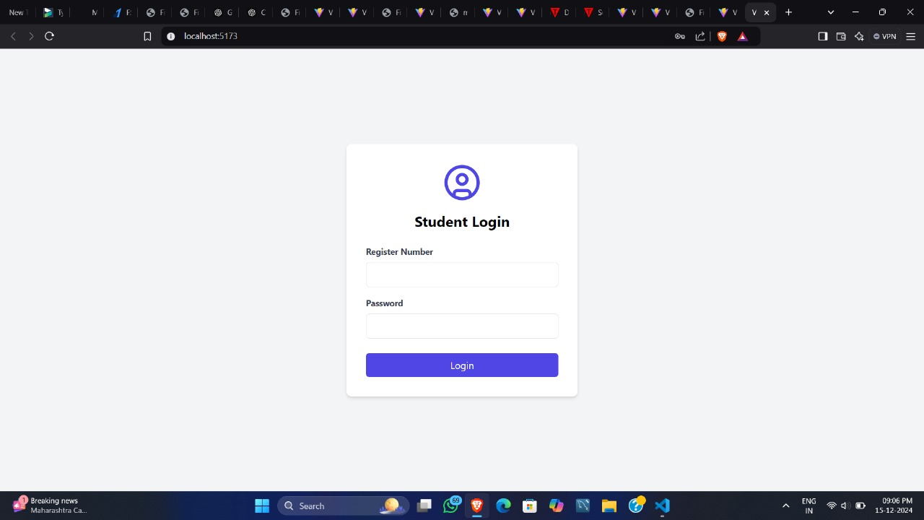
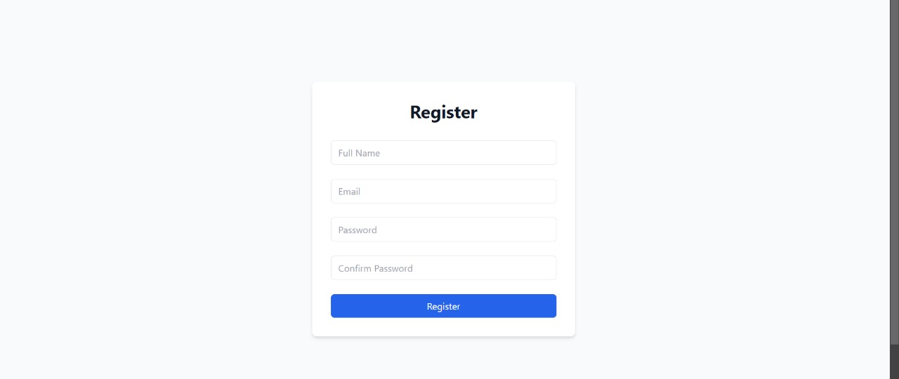
PROGRAM IMAGES

Slide 11
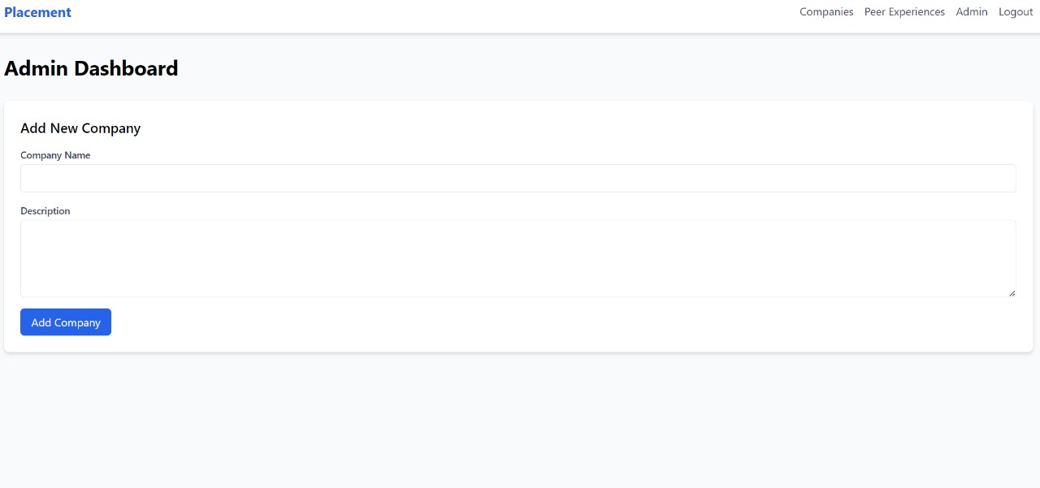

Slide 12
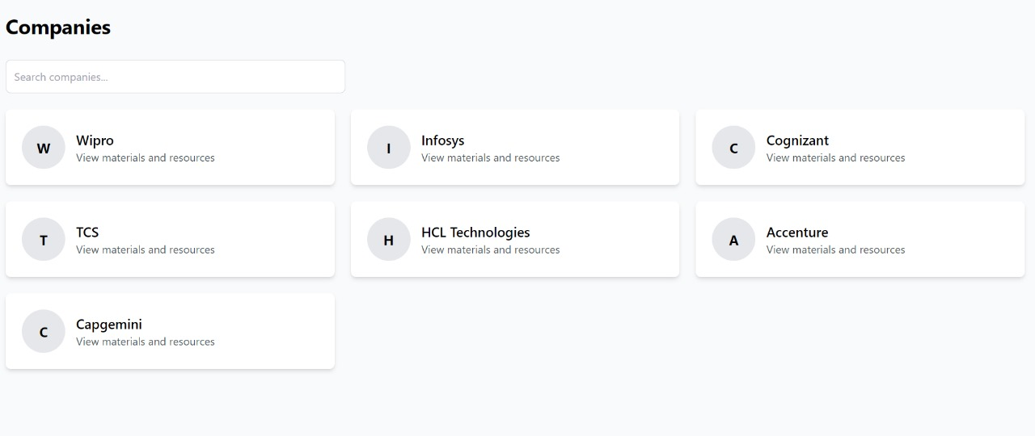

Slide 13
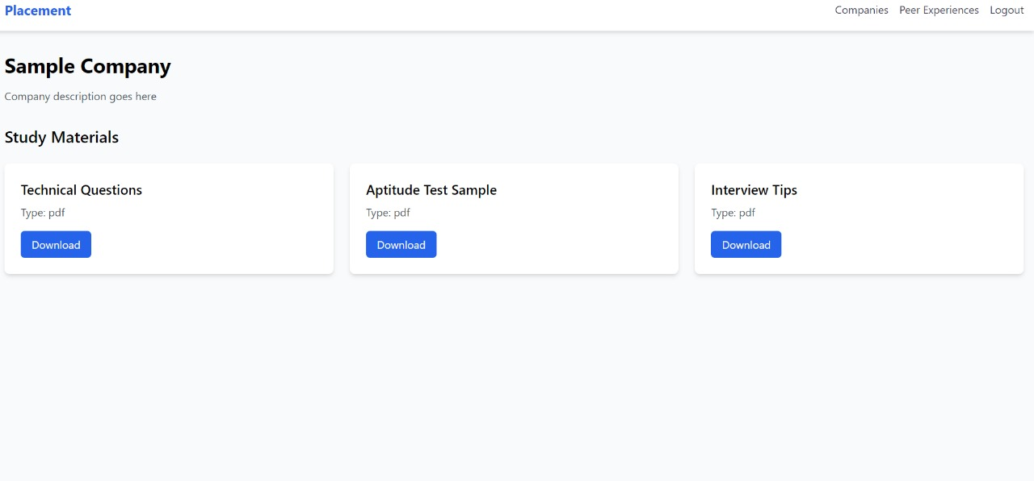

Slide 14
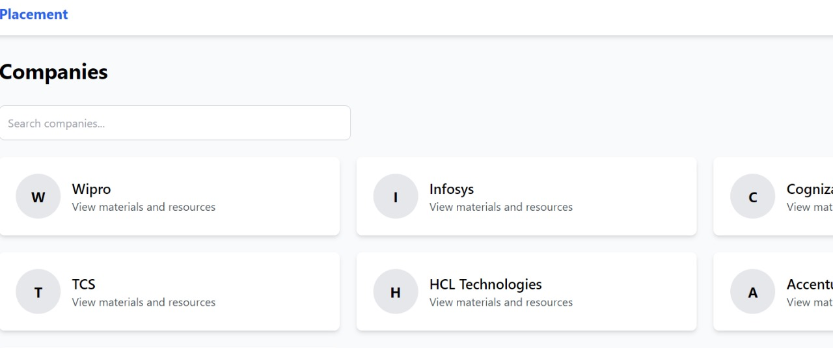

Slide 15
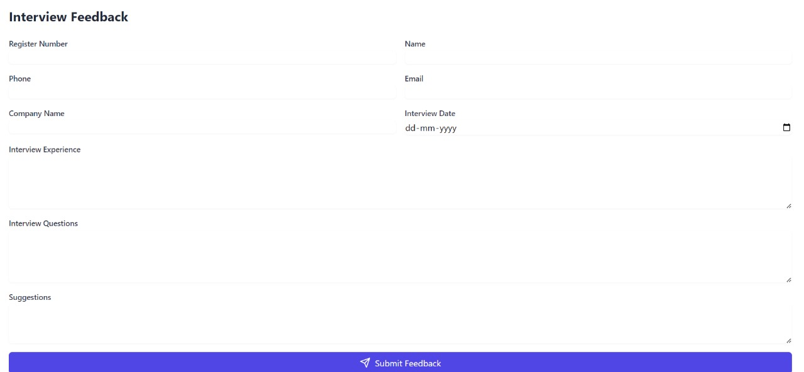

Slide 16
THANK YOU

